Slide 1
Coordinated Route Planning
2021CSB1078 - Jayrajsinh Chavda
2021CSB1076 - Atharva Mulay
2021CSB1116 - Nishad Dhuri

Slide 2
Problem Statement
Aim to develop a coordinated route planning algorithm that can optimize routes for an entire fleet of autonomous vehicles, taking into consideration real-time traffic conditions and the overall traffic flow.
Importance:
Traffic congestion means more energy and money consumption
Emerging trend towards urbanization and the rapid development of urban transportation
So, our aim is to reduce traffic congestion
Efforts:
Promoting Alternative travel modes
Car Pooling
Above methods causes inconvenience to drivers and travelers

Slide 3
Existing Methods
M* Search: M* is a standard approach for solving multi agent path planning algorithms (MAPPS). It starts with decoupled planning and dynamically increases the dimensionality of the search space in regions where collisions are occurring. Collisions occur when two or more agents are requiring the same resource. This allows us to efficiently search the joint graph with strict-collision free constraint thus minimizing the explored set.
Global Optimal Route (GOR) (Li, Chen, and Shang 2021): This algorithm applies Depth-First Search (DFS) on the road network to find all possible routes from source to destination .Then, a pruning technique is adopted enabling early termination of DFS technique.
Approximate equilibrium algorithm for congestion games (AECG) (Ravindran Vijayalakshmi and Skopalik 2020): This algorithm generates a sequence of improved moves that converge to an approximate pure Nash equilibrium in a polynomial number of best-response moves. It divides the players into blocks based on their costs, and players of two consecutive blocks are scheduled to make improving moves until converging to the equilibrium.

Slide 4
Challenges
Gap between User Equilibrium (UE) and System Optimum (SO): CRP aims to balance fairness (UE) and efficiency (SO). UE ensures users select convenient routes selfishly, but it doesn't minimize total travel time. SO prioritizes efficiency but is unstable and unfair. Reducing the gap between UE and SO, termed the "price of anarchy," remains a practical challenge in large-scale CRP systems.
Complexity in Coordinating Massive Routes: Assume that n drivers are planning their routes at the same time, and each trip may have k potential routes to connect the source and destination, there exist k n matching possibilities. Even after pruning, it is computationally complex, there exists 100s to 1000s of drivers in a city.
Dynamic Impact on Successive Traffic Situations: Transportation networks are subject to spatio-temporal dynamics. Congestion patterns evolve over time. Traffic assignments that work well in one situation may become inefficient in the next. Existing approaches typically rely on historical data to model and predict congestion, but this isn't conducive to real-time optimization. Addressing the dynamic nature of traffic and achieving real-time optimization remains a significant challenge in CRP systems.

Slide 5
Filling the Research Gap:
Bridging the user equilibrium and system optimum: We are using a region planner to reach user equilibrium . Then, a global planner can evaluate the combinations of strategies obtained by the regions, thus reaching the system optimum. Thus, we consider the whole system welfare, where the congestion problem is minimized, as well as individual fairness,if the users comply with the system’s routing advice.
Alleviating the curse of dimensionality: Traditional methods based on Markov game treat each driver as a player, and each player has an exponential number of paths from the source to destination,resulting in an explosion in state and action spaces.By using a modified Markov game,we significantly reduce the state-action space since each region planner is treated as a player,with its own action space.This reduces the action and state space , alleviating the curse of dimensionality problem
Simulation over the future to capture traffic dynamics: Used MCTS for narrowing down the explored future states.

Slide 6
Proposed Solution
We propose a bilevel optimization framework, consisting of regional planners and a global planner. Our framework applies sequence decision-making, i.e., time is divided into time slots {t, t + 1, · · · , T} and decisions are made for each time slot.
Region planner: Coordinates the route choices of vehicles within a region, eventually output several possible strategies, where each strategy contains the route choices of all vehicles in the region. This planner takes user fairness into consideration.
Global planner: Used to balance and evaluates the inter-region influence, and exploits simulations over the future to help decision-making. Since each region has got several possible strategies, this planner evaluates the combination strategies of all regions. Furthermore, exploiting digital twin-based ultra-high fidelity simulations, this planner simulates traffic state for the future steps {t + 2, t + 3, · · · } and adopts the simulated results for making informed decisions. However, the number of combination states is exponential with regions number and depth of simulations, therefore, we exploit the Monte Carlo tree search algorithm to achieve higher efficiency.

Slide 7
We are treating each region as a super player and M super players work together for coordinating the route choices of all drivers. For each region the available action space will be the combinations of actions of the drivers . Our framework simulates the future traffic and generates possible next states for each state. the global planner evaluates each state (e.g., the state is good if less congested) and further exploits the evaluation for narrowing down the search space. After simulation and evaluation for sufficient long steps, our framework provides insights to make an informed and effective decision at the current time step, i.e., the simulation results of several steps to help the local planner to select the best from all possible strategies.

Slide 8
Methodology
We define 4 objectives to consider while trying to achieve user equilibrium:
Objective A: minimum free-flow travel latency (the travel time when there are no other vehicles)
Objective B: minimum travel distance
Objective C: minimum number of traffic lights
Objective D: travel time with mutual influence
The Global Planner will use Monte Carlo Tree Search (MCTS) to select actions by lookahead search. The global planner coordinates the route choices of vehicles, selecting actions for each car such that each action is a user equilibrium under an objective.

Slide 9
Monte Carlo Tree Search (MCTS)
Monte Carlo Tree Search (MCTS) is a method for making optimal decisions in artificial intelligence (AI) problems, typically move planning in combinatorial games. It combines the generality of random simulation with the precision of tree search.It can handle complex games with massive search areas, in which traditional algorithms may struggle due to dimensionality problems.
MCTS combines the standards of Monte Carlo strategies, which rely upon random sampling and statistical evaluation, with tree-primarily based search techniques. Unlike traditional search algorithms that rely upon exhaustive exploration of the entire seek area, MCTS specializes in sampling and exploring only promising areas of the hunt area.
The center idea in the back of MCTS is to build a seek tree incrementally by using simulating more than one random performs (regularly known as rollouts or playouts) from the current recreation nation. These simulations are carried out until a terminal state or a predefined intensity is reached. The results of these simulations are then back propagated up the tree, updating the records of the nodes visited at some stage in the play, which includes the wide variety of visits and the win ratios.

Slide 10
MCTS algorithm involves generating a search tree node by node, according to the outcomes of simulated playouts . It can be divided into 4 major components:
Selection: From the root node, we recursively select the best child nodes till we reach a leaf.
Expansion: If we are at a leaf node which isn't the games terminal state, we will expand it to create child nodes and select one.
Simulation: We sample the next states and keep going until the terminal state is reached.
Backpropagation: The result we obtain at the terminal state is sent back to the node at which simulation started.
Each node must contain two values, the number of times it has been visited and the results obtained from simulations.

Slide 11
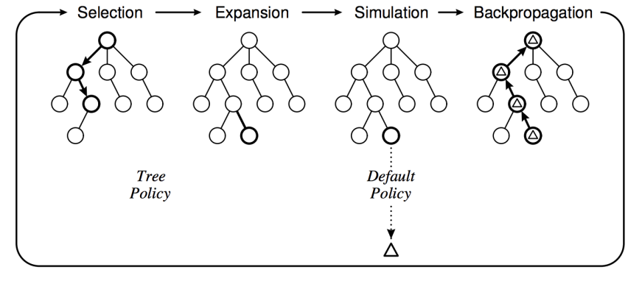
Illustrating the 4 components of MCTS

Slide 12
Conclusion
We have proposed a algorithm for coordinating routes, which is built on value function and Monte Carlo tree search algorithm.It can efficiently and effectively coordinate large-scale routes, and is capable of 1) bridging user fairness and system efficiency, 2) achieving higher search efficiency by alleviating the curse of dimensionality problem, and 3) making an effective and informed route planning by simulating over the future to capture traffic dynamics.

